Slide 1
USACC 104-R Preparation
Guidelines and Techniques
21Jan20
Notes:
Welcome to this presentation on preparing a United States Army Cadet Command form 104-R, Planned Academic Program Worksheet or 104-R.
Today, I will explain one technique to fill out the 104-R. While I will be referring to the program and resources at the University Park campus, the ideas presented should be adaptable to your location. If you are not attending Penn State, check out the online academic planning tools on your college’s website or meet with your academic advisor to understand your degree requirements.
This is a long video. My goal is to show you how to create a 104-R that will meet all the administrative and academic requirements for the form. You may not complete the form perfectly the first time, but you should be very close if you follow these instructions.
I will go into detail in four areas: Penn State degree requirements and resources, commissioning requirements for all ROTC cadets, a technique to create an initial set of classes for your degree, and block-by-block instructions to complete the 104-R. I suggest that you pause the video to take screen shots, especially where I provide website address, or have another browser or tab open so you can go to the sites as I discuss them. If possible, have a printer ready so you can print out a paper copy of your degree’s recommended academic plan.

Slide 2
Purpose
Upon completing this presentation, users should understand the ROTC and general university requirements for graduation, be able to draft an academic plan, and be able to properly fill out a USACC form 104-R.
NOTE: While this presentation is directed for Penn State Cadets, the principles should work for all Cadets using their university’s resources.

Slide 3
Resources Needed
Windows-based computer. (Apple/MAC computers corrupt the 104-R file).
Adobe Acrobat Reader (latest version).
September 2013 version of USACC form 104-R in .pdf format. (PSU: Use the one posted in Canvas).
University Bulletin (https://bulletins.psu.edu/undergraduate/)
Suggested Academic Plan for your major.
May also need:
Your degree audit (“What-if” report from Lion Path), if you have earned credits.
Notes:
Here are the minimum resources that you need:
Adobe Acrobat Reader (latest version)
September 2013 version of USACC form 104-R in .pdf format
University Bulletin (http://bulletins.psu.edu/undergrad/)
Penn State Recommended Academic Plan
May also need:
Your degree audit, if you have earned credits
Throughout the Fall 2015 semester, students running certain MAC operating systems could not fill out the 104-R on their computer. They needed to fill out and save the form on a Windows-based computer.

Slide 4
Requirements

Slide 5
USACC form 104-R
The USACC form 104-R is a required document for contracting with Army ROTC.
In support of earning a degree, the form documents a Cadet’s planned sequence of academic and ROTC courses that lead to graduation. Only one major is authorized.
The form also shows the number of credits and semesters or quarters the Cadet needs to graduate.
After contracting, the form is updated to document the Cadet’s academic progress.
Notes:
Only one major is authorized. The only time that you can include a minor on the 104-R is when a minor is required for your major. I will show you how to include the Military Studies minor later.

Slide 6
Penn State General Education Courses
All students seeking a Baccalaureate degree at Penn State must complete 45 credits in general education (Gen Ed) divided among the categories below. Some majors will double count specific required-for-major courses for certain general education classes. See https://bulletins.psu.edu/undergraduate/general-education/baccalaureate-degree-general-education-program/
Writing/Speaking (GWS): 9 credits
Quantification (GQ): 6 credits
Natural Sciences (GN): 9 credits (one class with a lab)
Arts (GA): 6 credits
Humanities (GH): 6 credits
Social & Behavioral Sciences (GS): 6 credits
Health and Wellness (GHW): 3 credits [Previously called Health & Physical Activity (GHA)]
(Note: consider the “Move 3” option to re-distribute 3 credits from and between those required in GN, GA, GH, GS, and GHW. You must take at least 3 credits in each Knowledge Domain.)
Diversity: A course for General Education or BA requirement can also count for either the US Cultures (US) or Intercultural/International (IL) requirement.
First-Year Seminar (S, T, X, or PSU)
Inter-Domain or Linked courses
If you use a pair of either Inter-domain (ID) or Linked (LK) courses as part of your general education requirement, these six credits are in lieu of three credits in GN, GA, GH, or GS and three credits in GN, GA, GH, or GS, but not six credits from one category. Your plan needs a total of 45 credits of Gen Eds with or without ID or LK courses.
FOUNDATIONS
KNOWLEDGE DOMAINS
Notes:
Links: https://bulletins.psu.edu/undergraduate/general-education/baccalaureate-degree-general-education-program/ Move 3 option: http://gened.psu.edu/move-3/
This is a good place to take a screen shot. I am going to spend several minutes on this slide because the university has several rules and concepts related to this topic. While you are earning your bachelor’s degree at Penn State, you must take 45 credits in general education (or Gen Eds) classes across seven categories. You must also take two diversity classes –one in US cultures and one in international cultures. Most of the time, one class can double count for both a diversity requirement and another requirement.
Each degree is a little different. Most programs have classes required for the major that the university has designated as general education classes. However, not all these classes can double count toward your major and toward your Gen Ed requirements –some may, some may not. For example, PL SC 014 is a Social & Behavioral Sciences (or GS) Gen Ed. If you are a pursuing a B.A. in Political Science or International Relations, this class is required for your degree, but it cannot also count for your GS requirement. However, if you are pursuing a B.S. in Political Science, then PL SC 014 counts for your degree and as a GS class. This course is also an international cultures diversity class. All three of these degrees let you can count this class toward the IL requirement and required for the major. Bottom line: see which classes can double count for your degree and the Gen Ed requirements. The recommended academic plans that I will show you shortly is one way to check; the university bulletin is another.
While the recommended academic plan will specify when to take the three GWS classes, you do have some flexibility if necessary. However, ENGL 015 or 30 must be taken before your sophomore year. You must be a junior or higher to take ENGL 202. CAS100 can be taken any semester. The honors sequence of CAS137 and 138 count for ENGL 15 and CAS 100 and are completed during the freshman year.
If you have a particular like or dislike of a particular category of Gen Ed, you can move 3 credits from category to another. In other words, you take 3 fewer credits in one area and take 3 more credits in another. You still need a minimum of three credits in each general education category. You must complete 9 credits of GWS and 6 credits in GQ – you cannot move any credits into or out of these two categories. However, you can move 3 credits out of GA, GH, GS, or GN and into GA, GH, GS, GN or GHW (GHA).
Classes designated as a US and/or IL diversity class can double count for another requirement except for the BA: Other Cultures requirement. You should have plenty of other classes to choose from that can double count for the IL and another requirement. ROTC runs a KINES 096, Independent Studies in Physical Education, for 1.5 credits every semester during the PRT portion of the Army course. This class counts for the GHW (GHA) gen ed. You can take the class twice.

Slide 7
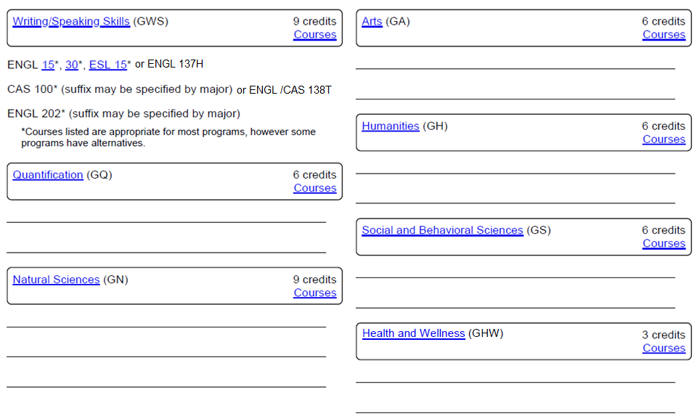
Print and use for planning
Penn State General Education Worksheet
or ENGL 137H
or ENGL / CAS 138T
Inter-domain (ID) or Linked Courses (LK) 6 credits (if used, three less credits in two categories each except GWS and GQ)
_______________________________________________
_______________________________________________

Slide 8
PME and Military Studies Minor
Students who decide to complete the ROTC program must take one authorized Military History course to fulfill one of the Professional Military Education (PME) requirements to be commissioned.
Although nine classes at Penn State have been approved for this requirement, your best option is to select one of the five that also count toward the General Education requirement. The five are: HIST 130 (GH), HIST 143 (GH), HIST 144 (GH), HIST 173 (GH), or PL SC 014 (GS).
OPTION: Penn State also offers a Military Studies Minor. Students who take 20 credits of ROTC plus six credits from list of over 40 classes may apply for this minor. See https://bulletins.psu.edu/undergraduate/colleges/intercollege/military-studies-minor/ for this list. Note: all the PME classes count toward this minor.
Consider taking HIST 454, American Military History. This is the Penn State class that best meets the intent of the Military History Course commissioning requirement. It satisfies both the PME and a Military Studies Minor requirement. It also counts toward the US cultures and a Bachelor of Arts (Humanities) requirements. However, you must take HIST 020 or HIST 021 first. Unfortunately, not everyone has the flexibility to include this course in their academic plan.
Notes:
You can take one of nine classes at Penn State to meet the Military History PME requirement. However, five of these classes are also general education classes. By taking one of these five, you are not adding to your course load. The five classes are Intro to the Civil War, History of Fascism and Nazism, World at War 1939-1945, Vietnam in War and Peace, and International Relations. The first four classes are Gen Eds in Humanities and the last is a Gen Ed in Social & Behavioral Sciences.
Penn State offers a minor in Military Studies. It requires 26 credits. 20 are the ROTC classes and six in selected history or political science. You can get the entire list from the bulletin. Click on Minors and navigate to Military studies.
If you can, try to take HIST 454, American Military History. You must first take HIST 20 or 21, which are GH classes, but HIST 454 is great for your professional development and it counts as one of the nine military history PMEs, the military studies minor, a BA class and a US cultures class.
Next, we will look at the recommended academic plan. This is a good place to pause and take a stretch break.

Slide 9
Planning

Slide 10
University Bulletin
Main site: https://bulletins.psu.edu/undergrad/
To look up courses, you can enter the exact course number within quotes, e.g. “Army 302” or click “Courses” from the menu to get the screen on the next slide.
Notes:
Penn State’s online bulletin can be found at https://bulletins.psu.edu/undergrad or you can type “bulletin” in the search box on Penn State’s home page.
Each page of the bulletin contains links to degree requirements, course descriptions, general education requirements, and Bachelor of Arts degree requirements.
There are also “Most Popular Searches” on the right side of the page has a link that will take you to all the Bachelor of Arts requirements and links that will take you to the list of courses that meet each category of general education requirements (GA, GH, GN, etc.)

Slide 11
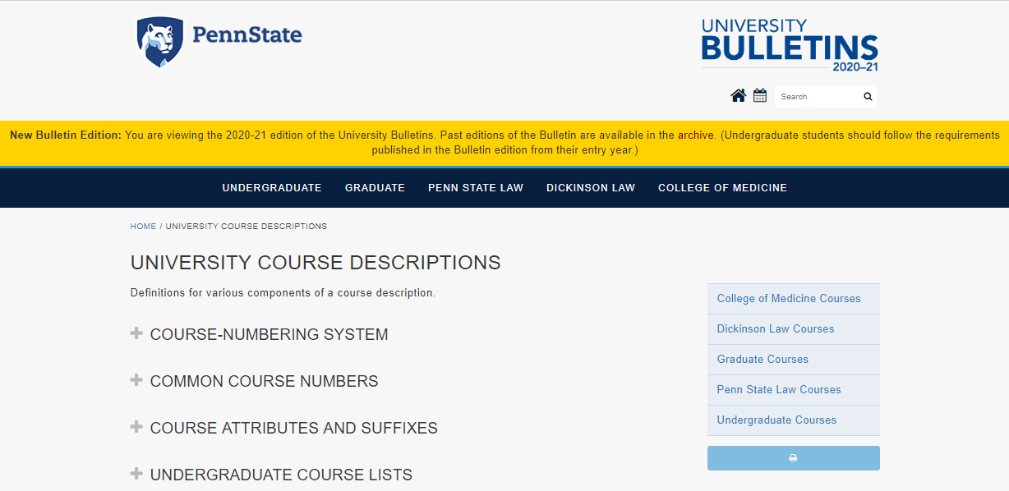
University Bulletin
On this screen, click “Undergraduate Courses” on the right side menu.
Notes:
Penn State’s online bulletin can be found at https://bulletins.psu.edu/undergrad or you can type “bulletin” in the search box on Penn State’s home page.
Each page of the bulletin contains links to degree requirements, course descriptions, general education requirements, and Bachelor of Arts degree requirements.
There are also “Most Popular Searches” on the right side of the page has a link that will take you to all the Bachelor of Arts requirements and links that will take you to the list of courses that meet each category of general education requirements (GA, GH, GN, etc.)

Slide 12
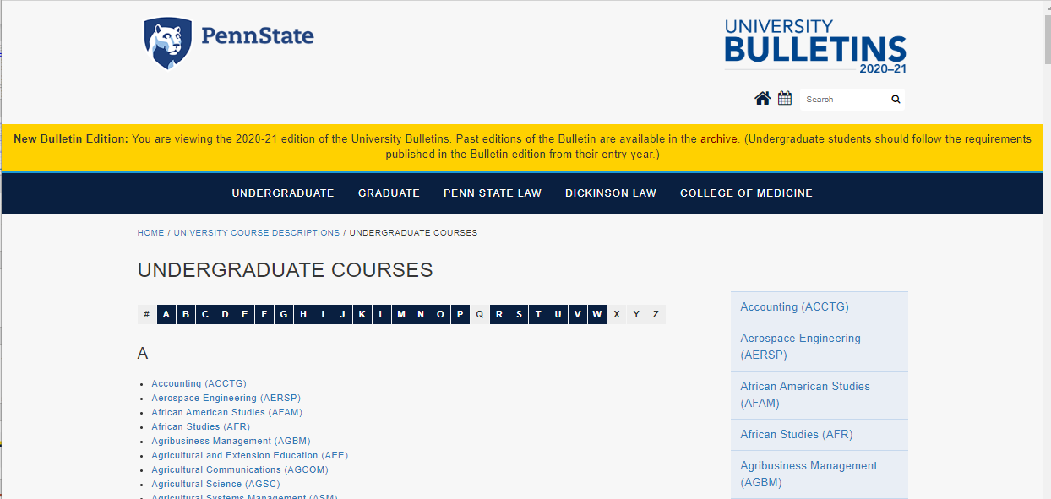
University Bulletin
On this screen, you can scroll to course subject, click on corresponding letter along the top to jump to that section of subjects, or use the right-side menu.
Notes:
Penn State’s online bulletin can be found at https://bulletins.psu.edu/undergrad or you can type “bulletin” in the search box on Penn State’s home page.
Each page of the bulletin contains links to degree requirements, course descriptions, general education requirements, and Bachelor of Arts degree requirements.
There are also “Most Popular Searches” on the right side of the page has a link that will take you to all the Bachelor of Arts requirements and links that will take you to the list of courses that meet each category of general education requirements (GA, GH, GN, etc.)

Slide 13
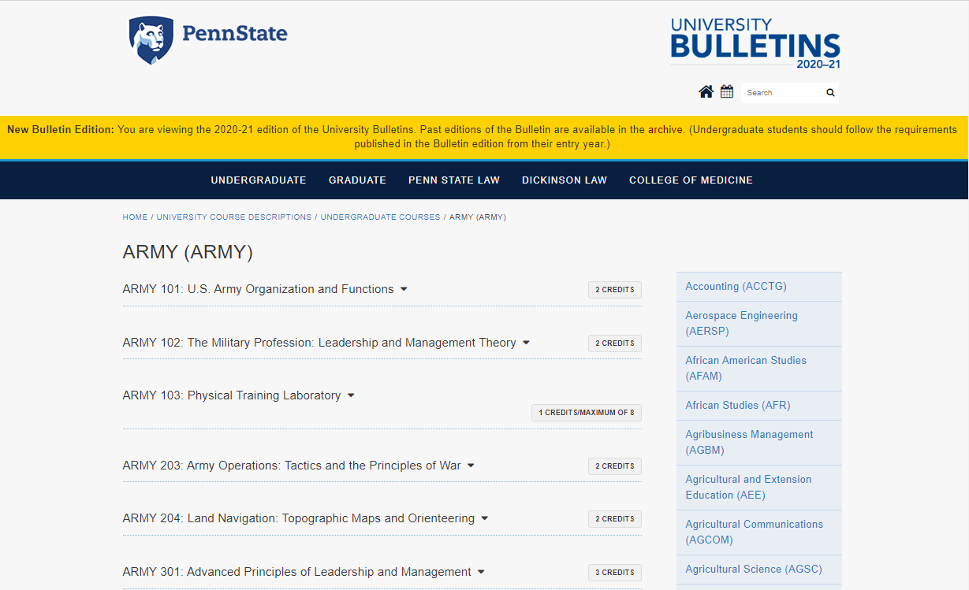
University Bulletin
By clicking on a subject like “Army”, you will then see all the classes in that subject offered at Penn State.
Notes:
Penn State’s online bulletin can be found at https://bulletins.psu.edu/undergrad or you can type “bulletin” in the search box on Penn State’s home page.
Each page of the bulletin contains links to degree requirements, course descriptions, general education requirements, and Bachelor of Arts degree requirements.
There are also “Most Popular Searches” on the right side of the page has a link that will take you to all the Bachelor of Arts requirements and links that will take you to the list of courses that meet each category of general education requirements (GA, GH, GN, etc.)

Slide 14
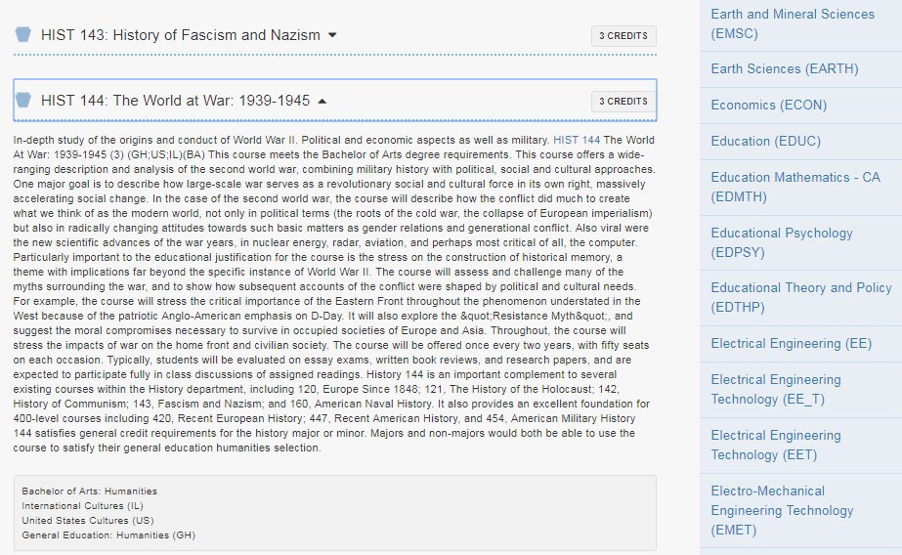
Individual Course Description
When you click on an individual course from the list of classes, the Bulletin will state the requirements the course may fulfill. In the example above, this course may satisfy either a Bachelor of Arts requirement in the Humanities field or a General Education in Humanities (GH). In addition, it can satisfy either the US or IL requirement (but not both).
Notes:
This is an example of a course description in the University Bulletin. Below the class description, the notes section - indicated within the red oval on this slide - will show which general education, diversity, and/or Bachelor of Arts requirements the course will satisfy. In this example, the class may fulfill multiple requirements. However, one class cannot count for both a General Education and a Bachelor of Arts requirement. This class also may satisfy either the US or IL requirement, but not both. Therefore, it could count for two requirements: either the General Education and one diversity or the B.A. requirement and one diversity. This page should also tell you if you need a pre-requisite or concurrent course in order to take this course. This particular course also one of the nine that counts toward the ROTC military history requirement which is covered next.

Slide 15
Suggested Academic Plan
Penn State has created a plan for most, if not all, four-year degree majors by option as applicable.
Start at : https://bulletins.psu.edu/undergrad/ (next slide)
Also, look at your college/department website (often under “Advising” or “Current Students”) for a “Roadmap” or “Handbook” or simply webpages that list any department required classes, options, or electives that may not be included with the Suggested Academic Plan.
Notes:
: https://bulletins.psu.edu/undergrad/
Penn State has created recommended academic plans for most, if not all majors offered by the university. If you are attending another college, check with your advisor or academic department if they have a similar document that lists the preferred sequence of classes for your major.
The intent of this video is for you to be able to create an academic plan that is almost ready for signature. By following the recommended academic plan for your major, you should be able to create a first draft of a 104-R that is acceptable or one that is close. You academic advisor may have some suggestions that will better meet you specific goals. Make any changes that your advisor requires or recommends. They have the final say if your plan is acceptable or not. Again, the goal of this video is for you to create a good first version of your plan.

Slide 16
University Bulletin
Main site: https://bulletins.psu.edu/undergrad/
If you started college this year, click “PROGRAMS” then “Baccalaureate Degree Programs,” and then your major. Otherwise, click “ARCHIVE,” the school year you started, then your major.
Notes:
Penn State’s online bulletin can be found at https://bulletins.psu.edu/undergrad or you can type “bulletin” in the search box on Penn State’s home page.
Each page of the bulletin contains links to degree requirements, course descriptions, general education requirements, and Bachelor of Arts degree requirements.
There are also “Most Popular Searches” on the right side of the page has a link that will take you to all the Bachelor of Arts requirements and links that will take you to the list of courses that meet each category of general education requirements (GA, GH, GN, etc.)

Slide 17
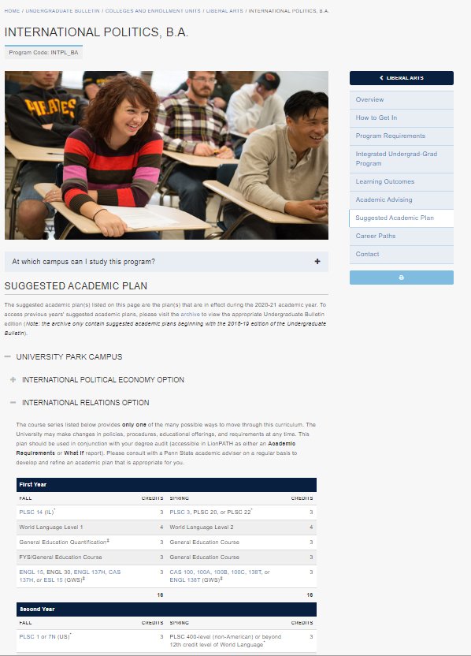
By clicking “Suggested Academic Plan” on the right side and then your campus and/or option (if applicable), a semester-by-semester plan.
One way to print this plan is to highlight the plan, but you should include the text above and below the table to keep the formatting, then click print.
Another way is to:
1. Change the magnification of your screen (hold the Ctrl key then press the “+” or “-” key to resize the display.
2. Use the “Snipping tool” or “Snip & Sketch” program (Windows) to capture a picture of the plan.
3. Paste the picture into Word or another program, then print.
If you click the Print options button and select “Download PDF of this page”, you will get a file with some planning details specific for the major.
Print options

Slide 18
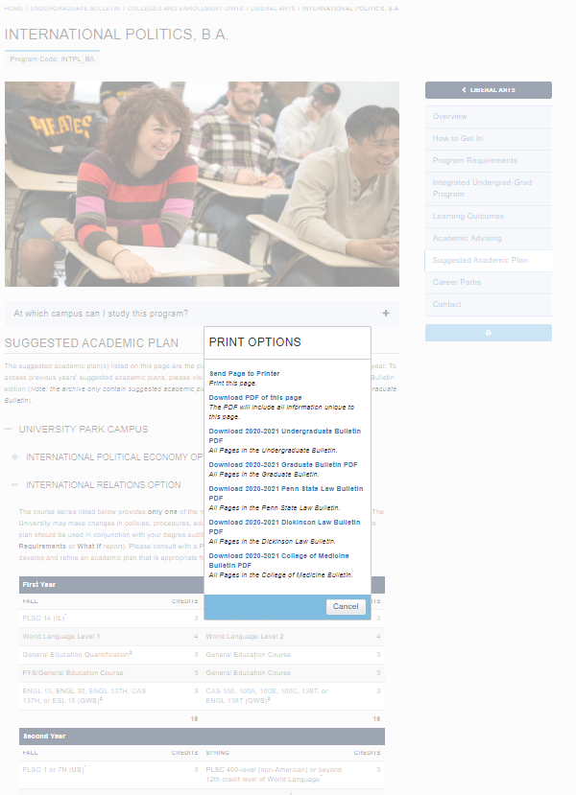
If you click on the Print Options button, select “Download PDF of this page” on the pop-up and you will get a file with some planning details specific for the major.

Slide 19
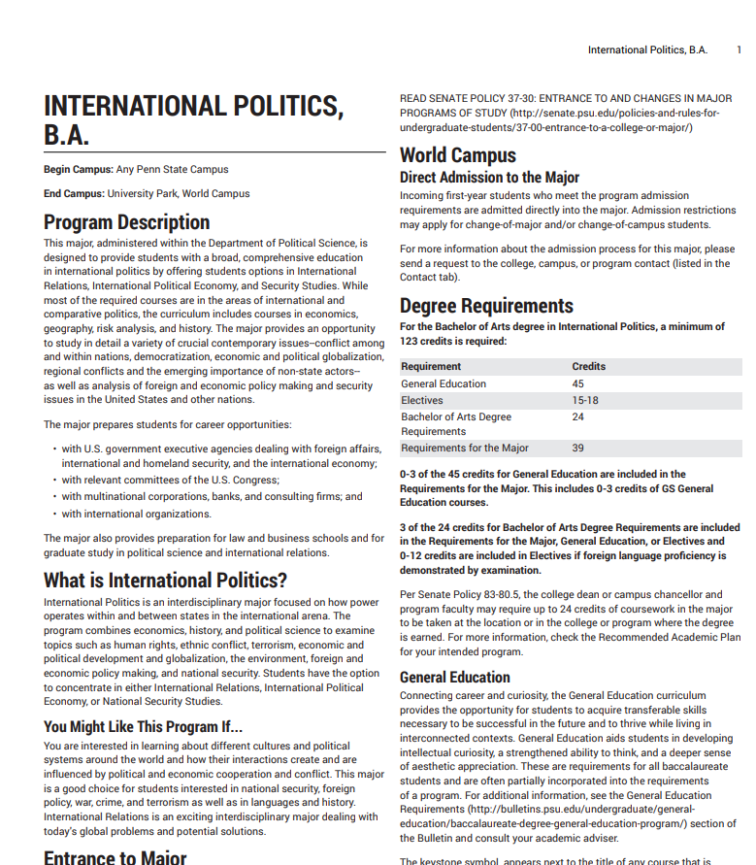
The downloaded PDF typically discusses the degree requirements, option and option requirements, if any, a smaller version of the suggested academic plan, and notes related to the academic plan.
You may need to review the department’s webpages to find any “Department list” of classes for certain degree requirements if the list not included on the PDF.

Slide 20
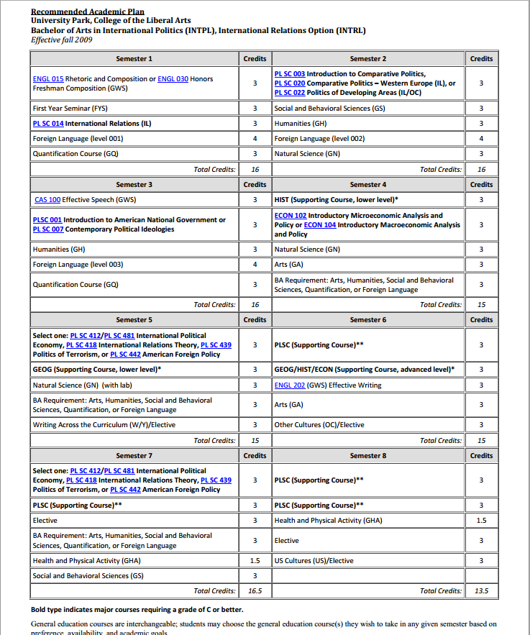
Use the printed Suggested Academic Plan as a worksheet to select classes that will go on your 104-R. Each class needs to satisfy a requirement. If necessary, you can change your choices later.
2. If your major specifies a selection of supporting courses, review the list of options posted either with the suggested plan, the PDF download, or on the department website.
Write in your choice for each requirement. In this example, a student should take a lower-level supporting course in HIST in the 4th semester, like HIST 120.
HIST 120
Begin with your classes required for your major.
1. Where you must take one class from a group of classes, pick one. Write in the class number where none are specified.
PL SC 413
GEOG 123
HIST 420
PL SC 410
PL SC 411W
PL SC 433
Notes:
Here is an example of a recommended academic plan for a BA in International Politics, International Relations option. On this sheet, you will write down a course for each requirement. If you have already scheduled or taken class, do not worry about the sequence now, just write which course you are taking to meet each requirement.
<Hit return> Start with the classes required for your major. One this example, they are underlined and in blue text. The three GWS classes and PL SC 014 are listed as required for major. For this major, PL SC 014 can count for the international cultures requirement but not the GS requirement because after the course name only (IL) is marked.
Other groups of required classes are listed in semesters 2, 3, 4, 5, and 7. Highlight the one you think that you want to take. (Be careful, some groups of classes, like those in semesters 5 and 7 are the same, so do not pick the same class twice).
<Hit return> Some majors require that you take a number of supporting courses. The major may divide these courses into different categories. The recommended plan may list these courses on subsequent pages. Typically, the department website discusses the supporting courses in greater detail. Look up the possible supporting courses and write in your preliminary choices for each of the requirements. One this example, a student would need to write in one lower level history course form the list, one lower level geography course from that list, one advanced history, geography, or economics course from that list, and four PL SC supporting courses from that list.
Remember, the 104-R is a working document, so you can change your mind on a specific course or if you have a scheduling problem, you can modify your choice of classes as long as you are mindful of prerequisite courses.

Slide 21
3. Select your General Education classes (Gen Eds).
For most majors, some of your required-for-major classes will also count for your General Education class. These will be specified. However, some required-for-major classes cannot double count as a Gen Ed. The recommended plan usually shows this. Remember to include a PME for one Gen Ed.
You do not need a separate class to meet the Diversity requirements - US cultures (US) and International cultures (IL). A required class, a General Education class, a B.A. requirement (except the B.A. Other Cultures class), or an elective can also count toward the US or IL class. Also one class cannot count toward both US and IL – only one of the diversity requirements.
(GS) PSYCH 100
(GH,US,PME) HIST 130
(GQ) MATH 021
(GN) BIOL 011
HIST 120
(GH) PHIL 001
(GN) EARTH 100
(GA) ART 020
(GQ) MATH 022
PL SC 413
GEOG 123
HIST 420
(GN)ASTRO 10+11
(GA) MUSIC 109
PL SC 410
PL SC 411W
PL SC 433
(GHW) KINES 96
(GHW) KINES 96
(GS) OLEAD 100
Notes:
Select your general education classes. In this example, none of the required for major or supporting classes except the three GWS classes count toward the general education requirements.
Remember to include at least one PME military history class for one of your gen eds. In this case, the PL SC 014 is a required for major class and can count for the PME class. Consider selecting other gen ed classes (six credits total) that count toward the military studies minor. If none of your required-for-major classes count as a diversity class, pick one gen ed to also meet the US cultures requirement and another gen ed to meet the IL cultures requirement. Some courses, like HIST 144, can fulfill either the US or IL requirement, but that one class cannot fulfill both. You need a second class to meet the second diversity requirement.
<Hit return> Notice in the second semester, HIST 130 was written in to fulfill the GH requirement. It also fulfils the military PME requirement and the US culture requirement. Write this down so you can mark it on your 104-R later.

Slide 22
Note: If you are exempt from a foreign language class due to a number of years of high school language classes, you still need 24 B.A. credits.
You do not get the academic credits if you are exempted from a class or two.
You can only get academic credits if you have accepted AP test scores in the language or college transfer credits.
4. If you are pursuing a B.A. degree, you must include up to 24 credits of B.A. classes, including a foreign language up to the 12-credit level (the third class in an introductory language sequence).
(GS) PSYCH 100
(GH,US,PME) HIST 130
(BA) SPAN 001
(BA) SPAN 002
(GQ) MATH 021
(GN) BIOL 011
HIST 120
(GH) PHIL 001
(GN) EARTH 100
(BA) SPAN 003
(GA) ART 020
(GQ) MATH 022
(BA) RL ST 130
PL SC 413
GEOG 123
HIST 420
(GN)ASTRO 10+11
(BA,OC) ANTH 011
(GA) MUSIC 109
PL SC 410
PL SC 411W
PL SC 433
(GHW) KINES 96
(BA) RUS 100
(GHW) KINES 96
(GS) OLEAD 100
Notes:
Select your general education classes. In this example, none of the required for major or supporting classes except the three GWS classes count toward the general education requirements.
Remember to include at least one PME military history class for one of your gen eds. In this case, the PL SC 014 is a required for major class and can count for the PME class. Consider selecting other gen ed classes (six credits total) that count toward the military studies minor. If none of your required-for-major classes count as a diversity class, pick one gen ed to also meet the US cultures requirement and another gen ed to meet the IL cultures requirement. Some courses, like HIST 144, can fulfill either the US or IL requirement, but that one class cannot fulfill both. You need a second class to meet the second diversity requirement.
<Hit return> Notice in the second semester, HIST 130 was written in to fulfill the GH requirement. It also fulfils the military PME requirement and the US culture requirement. Write this down so you can mark it on your 104-R later.

Slide 23
5. If you have any electives, apply ARMY classes to theses requirements. Start with Army 402 in the last semester that has electives and work backwards.
On the 104-R, the ARMY classes must be taken in sequence.
Army 101, 102, 203, and 204 are two credit classes.
Army 301 and above are three credit classes.
6. Mark your choice for your First Year Seminar (FYS).
PSU 006
(GS) PSYCH 100
(GH,US,PME) HIST 130
(BA) SPAN 001
(BA) SPAN 002
(GQ) MATH 021
(GN) BIOL 011
HIGHLY RECOMMEND THAT YOU COMPLETE YOUR MILITARY HISTORY COURSE (PME) BY THE END OF YOUR SOPHOMORE YEAR!
HIST 120
(GH) PHIL 001
(GN) EARTH 100
(BA) SPAN 003
(GA) ART 020
(GQ) MATH 022
(BA) RL ST 130
PL SC 413
GEOG 123
HIST 420
(GN)ASTRO 10+11
(BA,OC) ANTH 011
(GA) MUSIC 109
ARMY 204
/2
--14
ARMY 301
PL SC 410
PL SC 411W
PL SC 433
ARMY 302
(GHW) KINES 96
(BA) RUS 100
ARMY 401
(GHW) KINES 96
ARMY 402
(GS) OLEAD 100
Notes:
Use ARMY class to meet any elective credits. On the worksheet, start with the last semester that has an elective and write in ARMY 402. As you move to earlier semesters, add the ARMY class in reverse order. On the recommended plan write in ARMY 402, then ARMY 401, 302, 301, 204, and so on until all the electives have filled, or you have filled in all the ARMY classes (20 credits). ARMY 101 through 204 are two credits each. ARMY 301 and above are three credits each.
<Hit return> Enter the course number of your first year seminar.

Slide 24
All requirements should now have a specific class marked to fulfill that requirement. Remember you can change your choice of Gen Ed, B.A., and option classes, like supporting classes, later.
You will enter the classes on the 104-R in the semester that they appear on the suggested plan, with some special exceptions.
One case will be those with 9 semesters authorized for their major. Most engineers will be allowed an extra semester. Move four Gen Eds from the junior and senior years to this 9th semester .
PSU 006
(GS) PSYCH 100
(GH,US,PME) HIST 130
(BA) SPAN 001
(BA) SPAN 002
(GQ) MATH 021
(GN) BIOL 011
HIST 120
(GH) PHIL 001
(GN) EARTH 100
(BA) SPAN 003
(GA) ART 020
(GQ) MATH 022
(BA) RL ST 130
PL SC 413
GEOG 123
HIST 420
(GN)ASTRO 10+11
(BA,OC) ANTH 011
(GA) MUSIC 109
ARMY 204
/2
--14
ARMY 301
PL SC 410
PL SC 411W
PL SC 433
ARMY 302
(GHW) KINES 96
(BA) RUS 100
ARMY 401
(GHW) KINES 96
ARMY 402
(GS) OLEAD 100
Notes:
You should now have a specific class for each degree requirement. Remember you can change your choice of Gen Ed, B.A., and option classes like the supporting classes in this example later
You will use these selections to fill out your 104-R, semester by semester, with some special exceptions.
One case will be those with 9 semesters authorized for their major. Some STEM majors and all engineering majors except nuclear engineering will be allowed an extra semester. Those students will move four Gen Eds from the junior and senior years to this 9th semester and add ARMY 496, independent study in military science, to the semester. For ROTC scholarship winners, the Army will pay for the 9th semester.

Slide 25
The suggested academic plans properly sequence prerequisite courses for later semesters.
If during your first semester you are taking or took a class that the plan has for a later semester, switch as few classes as needed to get back on track.
In some cases if you miss a prerequisite, you will delay your graduation by a year and thus violate your contract.
If it helps, you can mark those classes taken out of order with the semester number you plan to take them.
Most Gen Eds that are not required-for-major can be taken anytime.
Use this worksheet to complete your 104-R. Transfer this information to your 104-R following the guidance on the rest of this presentation.
PSU 006
(GS) PSYCH 100
1
(GH,US,PME) HIST 130
(BA) SPAN 001
(BA) SPAN 002
2
(GQ) MATH 021
(GN) BIOL 011
HIST 120
(GH) PHIL 001
(GN) EARTH 100
(BA) SPAN 003
(GA) ART 020
(GQ) MATH 022
(BA) RL ST 130
PL SC 413
GEOG 123
HIST 420
(GN)ASTRO 10+11
(BA,OC) ANTH 011
(GA) MUSIC 109
4
ARMY 204
/2
--14
ARMY 301
5
PL SC 410
6
PL SC 411W
PL SC 433
ARMY 302
(GHW) KINES 96
(BA) RUS 100
ARMY 401
7
8
(GHW) KINES 96
ARMY 402
(GS) OLEAD 100
25
Notes:
One advantage of using the recommended academic plan to outline your sequence of classes is that the recommended academic plan already put the prerequisite courses before the class or classes that need those prerequisite courses. Also, some required classes are only offered once a year – either in the fall or in the spring semester. By keeping the specified required-for-major class in the semester, you will not risk missing a class resulting in a delay of your graduation by a year and thus violate your contract.
You may have some classes on the recommended plan that are not in the semester that you will actually take them. These should be limited to the ARMY classes and possibly classes that you took or are taking in your first semester. I suggest marking those classes with the number of the semester you will take them <return> like on the example.
Notice that the first semester on the example worksheet lists ENGL 15, PSU 006, PL SC 14, SPAN 001, and because the example person took a GH their first semester instead of a GQ (or math) class, HIST 130 from the semester 2 list. These five would appear in the first semester on the 104-R like on the following example.

Slide 26
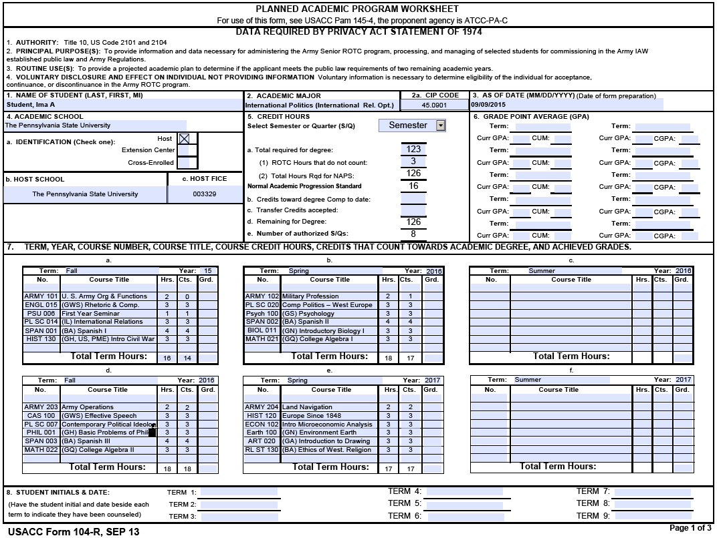
USACC form 104-R filled out using worksheet (1 of 2)
Notes:
Notice that each semester starts with the ARMY class, then lists the classes from the worksheet. The first semester has ARMY 101, then ENGL 15, PSU 006, PL SC 14, SPAN 001, and HIST 130 like our example academic plan. The remaining semesters are filled out with the classes written down on the recommended academic plan worksheet.

Slide 27
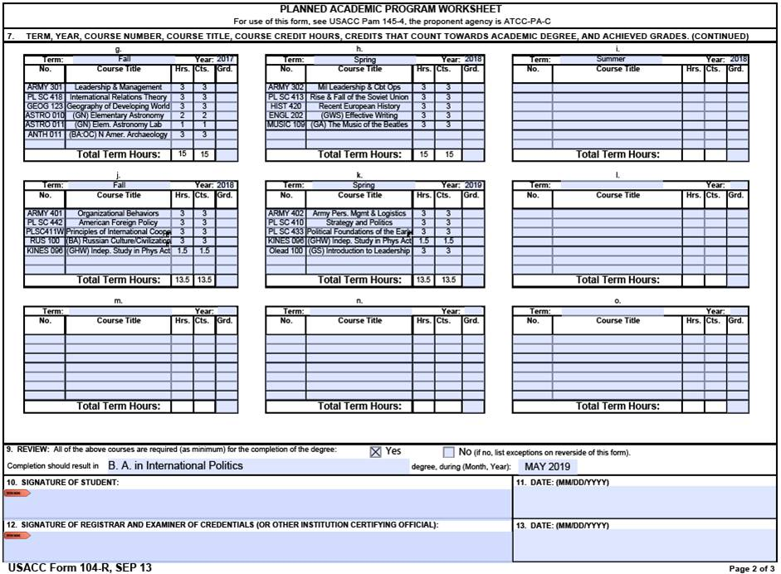
USACC form 104-R filled out using worksheet (2 of 2)
Notes:
The last four semesters are recorded on the second page of the 104-R. Later, I will explain why we lay out the semesters on the 104-R as shown on these two pages.

Slide 28
USACC form 104-R
PLANNED ACADEMIC PROGRAM WORKSHEET
The remainder of the presentation will cover completing the 104-R block by block.
Highly recommend that you obtain a copy of the 104-R that has some of the common information already filled in. Typically, a copy can be found on Canvas for your Army class. Alternatively, you can download a copy from the links at the end of this presentation.
Please note that you must save (download) the file to your computer hard drive, then open it with Adobe Reader. If you try to open it in your web browser (which has been the default program for pdf file in PSU computer labs), you may get an error or warning saying; “Please wait…”
Notes:
Now we will look at filling out the USACC form 104-R itself. This may be a good time to pause the video for one more stretch break.
[OPTION: SWITCH SCREENS TO A WEB BROWSER AND GET A COPY] You can download a blank copy from the Penn State Army ROTC website at army.psu.edu and click Resources/Information, then click on Cadet Resources.
Please note that you must save (download) the file to your computer hard drive, then open it with Adobe Reader. If you try to open it in your web browser, you may get a error or warning saying; “Please wait…”

Slide 29
Page 1 – Basic Information
Name, Academic Major, As of Date – See next slide for guidance.
Academic School – The Pennsylvania State University (or Penn State Altoona)
Identification – Host (Altoona Cadets check “Extension Center”)
Host School – The Pennsylvania State University
FICE – 003329
CIP Code – ROO Office can provide (PSU vs USACC Majors). Do not type the period in the CIP Code.
As of Date – Date you last updated the form.
GPA – Filled in by term . Curr GPA is your semester GPA; CGPA is your Cumulative GPA.
Form Version – September 2013
Cadet Initials – Completed every term during counseling. Leave blank for now.
Notes:
We will go over several of these boxes in the following slides. The 104-R is a living document, meaning that you will update it at least once a semester. For each semester, you will put the semester and year, like Fall 2016, in the Term block, then your semester grade point average (or GPA) in Curr GPA and your cumulative GPA where it is marked CUM or CGPA. Leave block 8 blank. Make sure the form version is September 2013 or later.

Slide 30
Blocks 1-3
Block 1. Name (Last, First, MI)
Block 2. Academic Major: The name of your major, e.g. Civil Engineering. Include the name of the option (abbreviated) if applicable, e.g. International Politics (Intern’l Rel. Opt).
Block 2a. CIP Code. The six-digit Classification of Instructional Programs code for your major. Do not type the decimal point; the form will automatically insert it.
Block 3. As Of Date (MM/DD/YYYY). The date you prepared the USACC form 104-R.
Notes:
Block 1 is simply your name: last name, first name and middle initial. Block 2 is the name of your major. If your major has options, put a shortened name of it in parenthesis
Block 2a is the CIP code. Every school has assigned a CIP code to each major. Leave blank unless your instructor or the recruiting operations office provides that information.
Block 3 is the date you updated the form. Keep this current to ensure that you are working with your most current version.

Slide 31
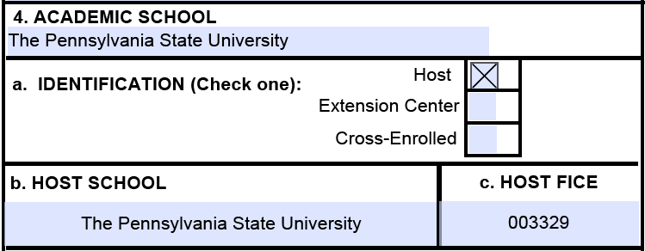
Block 4
The above is for University Park Cadets.
Altoona Cadets will use “Penn State Altoona” for the Academic School and check “Extension Center” in 4a.
Blocks 4b. And 4c. will be the same for UP and Altoona Cadets.
Notes:
The example is for University Park Cadets.
Altoona Cadets will use “Penn State Altoona” for the Academic School and check “Extension Center” in 4a.
Blocks 4b. and 4c. will be the same for UP and Altoona Cadets.

Slide 32
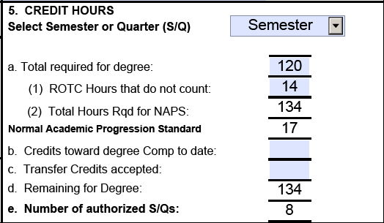
Block 5 – Normal Academic Progression Standard
Total Required for Degree – Strictly credits that Penn State requires ANY STUDENT to complete for a degree. See PSU Bulletin.
ROTC Hours that do not count – All eight ARMY classes total 20 credits. Subtract the number of elective hours from 20 (or the total number of credits for the ARMY classes that you will take). If total number of authorized semesters is 9, then the total number of ROTC class credits is 23.
Credits toward degree Comp to date – Enter only credits completed at a Penn State campus that counts toward your degree PLUS any ARMY credits that do not count toward your degree.
Transfer Credits accepted – AP Courses and transfer credits approved through PSU and count toward your degree. Do NOT include these on 5b.
The number in 5e is the number of semesters to build your plan upon (the current semester is included in this number). Most engineers and select other majors required 9 total semesters to complete their major plus ROTC classes. Notes:
5b. Do NOT include AP or approved transfer credits.
If 5e. Number or authorized S/Qs: calculates to 9, add three more hours to line 5a.(1) ROTC Hours that do not count and include ARMY 496 in that last (9th) semester.
Notes:
Block 5 is the most critical portion of this form. Listen closely. The information here will determine how many semesters you have to complete your degree and ROTC requirements. This will affect the number of semesters that an ROTC scholarship will cover. I recommend that incoming Cadets wait until after contracting to apply AP credit and transfer credits to their Penn State degree.
Penn State Cadets need the top part of block 5 to say “Semester”.
5a. is the number of credits needed to earn your degree. You can look this up on the bulletin under Baccalaureate Programs then your degree. The minimum number of credits is listed in the degree description. Penn State requires 120 or more credits for a Baccalaureate degree.
5a(1) is the number of ROTC credits that do not count. All eight ARMY classes total 20 credits. Subtract the number of elective hours from 20. If you find that you are authorized 9 semesters, subtract elective hours from 23 because you will take an additional ARMY class in that 9th semester. All engineering majors except Nuclear Engineering can count 6 ROTC credits and are authorized 9 semesters, so these Cadets will have 17 in 5a(1). If you followed the earlier process of using the recommended academic plan to determine your classes. you should know how many ROTC hours that you used for your electives.
5b. is the number of credits completed at a Penn State campus and THAT COUNT TOWARD your degree. After your first semester, include credits that count to your degree plus the total ROTC credits in 5b. Do not include remedial classes to qualify for required classes. For example, if you need to take Plane Trigonometry or Geometry before you can take your required Calculus I and Calculus II class, do not include the Trig or Geometry credits. Do not include your AP and transfer credits in 5b.
5c. is the total of your AP and transfer credits that you transferred in and that COUNT toward your degree. The biggest mistake Cadets make in this block is that they put their AP and transfer credits in both 5b and 5c. That inappropriately double counts those credits and calculates the wrong number of authorized semesters.

Slide 33
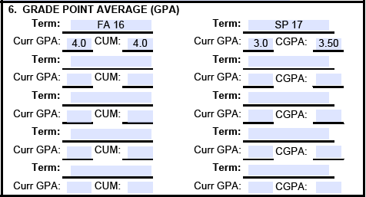
Block 6 – Grade Point Average (GPA)
As you progress through your college career, add your GPA each term. Curr GPA is your semester GPA; CUM or CGPA is your Cumulative GPA.
Notes:
GPA – Filled in each term. Curr GPA is your semester GPA; CUM or CGPA is your Cumulative GPA.

Slide 34
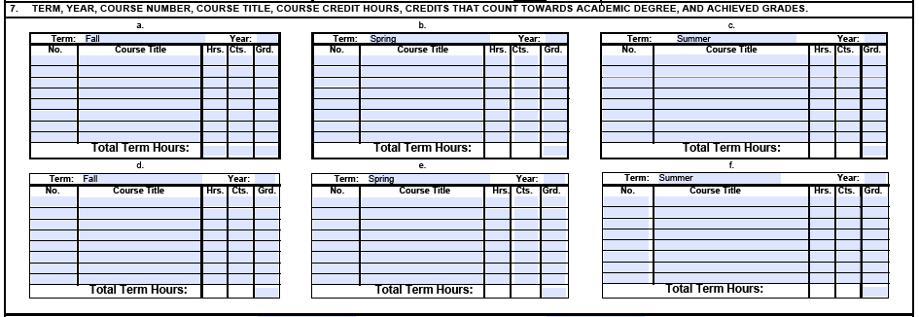
Block 7 – Semester Planning
Semester Plans – Semesters should be laid out chronologically, from left to right; each row represent one SCHOOL year; the three boxes represent Fall, Spring and Summer semesters; ONLY Penn State courses are included (no transfer or AP credits)
Take the classes that you selected on your Suggested Academic Plan worksheet and place them in the appropriate semesters on the 104-R. Although we mark the right columns (7c, 7f, 7i, 7l) as summer semesters, you cannot plan to take any summer classes (except certain required internships). The Army will not pay for summer sessions and you must have a plan that shows how you can complete your degree with taking classes only fall and spring semesters.
Notes:
Semesters should be laid out chronologically, from left to right; each row represent one SCHOOL year; the three boxes represent Fall, Spring and Summer semesters; ONLY Penn State courses are included on the plan (no transfer or AP credits).
Take the classes that you selected on your Recommended Academic Plan worksheet and place them in the appropriate semesters on the 104-R.
Even if you plan to take summer classes at your own expense, you cannot project any future summer classes except required internships (like SRA majors for example). Leave this space open so if you take a summer class, you can modify your 104-R without rewriting the whole plan. On this form, you can only copy one cell at a time.

Slide 35
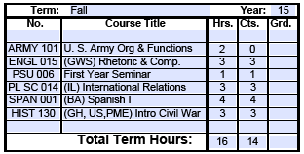
Block 7 – Semester Planning
Term – Fall/Spring/Summer
No. – PSU Course Number (ex. PLSC 014) . Ensure that the entire number can be read (if necessary, capitalize only the first letter, e.g. Geosc002).
Course Title – PSU Course Title. If the course satisfies a General Education or BA requirement for you, indicate it before the course title (see example).
Hrs. – Number of Credits (sometimes called “credit hours”)
Cts. –Credits that Count Toward Degree; while typically the same as the number of credit hours, not all classes count for your degree or only some of the credits will count for your degree.
Grd. –Grade: fill in with the letter grade earned (A, B+, etc.).
Upon completion of the 104-R, every requirement for the degree should have a specific course that will satisfy that requirement (in some cases, one course may satisfy more than one requirement. For example, HIST 130 will fulfill both a GH and US cultures requirements).
If a course fulfills YOUR General Education, US or International cultures, BA requirement, and/or a PME, indicate the requirement in parentheses in the course title column before the shortened name of the class, e.g. (BA) Spanish I; (GH,US,PME) Intro Civil War (see above).
Note: Do NOT mark every class that could be a Gen Ed or BA course-ONLY the courses that
will count for YOUR 45 credits in Gen Ed and/or 24 credits for the BA requirement.
The form cannot have any ‘placeholders’ like “400-level PL SC”; “GA, GH, or GS course”;
The total number of Hrs. (plus transfer credits in block 5c) should equal the number in 5a(2).
The total number of Cts. (plus transfer credits in block 5c) should equal the number in 5a.
Notes:
In each of the paragraphs (semesters) in block 7, enter Fall, Spring, or Summer in Term. For the year, put year in two-digit or four digit format. 7a will only properly show a two-digit year. Under number (No.) enter the PSU Course Number (ex. PLSC 014). Ensure that the entire alpha-numeric can be read (if necessary, remove spaces and capitalize only the first letter, e.g. Geosc002).
Course Title – Enter the PSU Course Title. If the course satisfies a General Education, BA requirement, diversity requirement or PME indicate it before the course title (see example – ENLG 15 is a GWS, PL SC 014 is an IL for this plan, SPAN001 is a BA class, and HIST 130 can count for GH, US and PME). Only mark the classes that you plan to take met the Gen Ed, BA, diversity or PME. For example, a biology major will take over 20 credits of classes that are classified as general education in Natural Sciences (GN) courses, but only the first 9 credits will count as gen eds. Only one class needs to be marked as your military history PME course. Only one course can include the US or IL diversity designation although that course can also count for a gen ed or BA (except BA: other cultures)
The form cannot have any ‘placeholders’ like “400-level PL SC”; “GA, GH, or GS course”; if you followed the recommended academic plan technique, you should have selected a class that meets each requirement.
Hrs. – PSU Scheduled Course Hours
Cts. –Hours that Count Toward Degree; while typically the same as the number of Hours, not all classes count for your degree or only some of the credits will count for your degree. Please note that the cells on the first page will round up classes that include a half credit. In other words, when you type in 1.5 the form will show “2” but the form uses 1.5 to add up the hours and credits that count. Type in the correct number and do not worry about the number displayed in that cell.
Grd. –Grade; fill in with the letter grade earned (A, B+, etc.).
When you are done, the total number of Hrs. (plus transfer credits in block 5c) should equal the number in 5a(2).
The total number of Cts. (plus transfer credits in block 5c) should equal the number in 5a.
If you planned classes total one or two credits more than the number in 5a or 5a(2), that is OK. If your planned classes total three or more credit beyond the number in 5a or 5a(2), then you likely have an extra class or two that you do not need. However, if you used the recommended academic plan technique, you should have right number or be over by just one or two credits.

Slide 36
Once you get to paragraph 7 of the 104-R, use the academic plan with your class choices to complete the 104-R.
The first class each semester should be your ARMY class (so you do not forget it).
For the first semester for someone using this example worksheet, they would enter ARMY 101 then simply enter the first semester classes (ENGL 15, PSU 006, PLSC 14, SPAN 001, HIST 130).
The second semester would begin with ARMY 102 followed by: PL SC 020, PSYCH 100, SPAN 002, BIOL 011, MATH 021.
Continue to fill in the remaining semesters on the 104-R with the ARMY class and the classes from the worksheet.
The next few slides show the 104-R based on this example worksheet.
PSU 006
(GS) PSYCH 100
1
(GH,US,PME) HIST 130
(BA) SPAN 001
(BA) SPAN 002
2
(GQ) MATH 021
(GN) BIOL 011
HIST 120
(GH) PHIL 001
(GN) EARTH 100
(BA) SPAN 003
(GA) ART 020
(GQ) MATH 022
(BA) RL ST 130
PL SC 413
GEOG 123
HIST 420
(GN)ASTRO 10+11
(BA,OC) ANTH 011
(GA) MUSIC 109
4
ANTH 011(OC)
5
ARMY 204
/2
--14
ARMY 301
PL SC 410
6
PL SC 411W
PL SC 433
ARMY 302
(GHW) KINES 96
(BA) RUS 100
ARMY 401
7
8
(GHW) KINES 96
ARMY 402
(GS) OLEAD 100
36
Notes:
Once you get to paragraph 7 of the 104-R, use the academic plan with you class choices to complete the 104-R.
The first class each semester should be your ARMY class (so you do not forget it).
For the first semester for someone using this example worksheet, they would enter ARMY 101 then simply enter the first semester classes (ENGL 15, PSU 006, PLSC 14, SPAN 001, HIST 130).
The second semester would begin with ARMY 102 followed by: PL SC 020, PSYCH 100, SPAN 002, BIOL 011, MATH 021.
Continue to fill in the remaining semesters on the 104-R with the ARMY class and the classes from the worksheet.
The next few slides show the 104-R based on this example worksheet.

Slide 37
Notes:
Notice all the administrative information for blocks 1 thru 5 are completed.
The first four semesters are on this page with nothing planned for the summer session.
Notice how the Gen eds, BA, diversity, and PME courses are marked. All course numbers are visible. As long as the complete course number is legible, the course title can run a little long like PHIL 001 in the Fall 2016 semester.

Slide 38
Block 8 – Student Initials
Student Initials & Date: – When creating your 104-R the first time, leave this section blank. Only complete one semester at a time when reviewing your 104-R with your Army ROTC instructor each semester.
Block 8:
First 104-R: Leave blank for now. When the Cadet reviews their 104-R with their ARMY instructor, they initial for the current semester only.
Updated 104-Rs: Re-initial the terms reviewed with the original dates that previous 104-Rs were reviewed. Do NOT enter the same date for all terms.
For example, if a Cadet reviewed their first semester 104-R on 15 SEP 18 and their second semester 104-R on 25 JAN 19, then all updated 104-Rs will have initials and 15 SEP 18 in the TERM 1 block and initials and 25 JAN 19 in the TERM 2 block.

Slide 39
Blocks 9 - 13 – Review Certification
9. Review – Mark the “Yes” block; add the degree type and name; add the expected graduation date (month and year)
10 & 11. Signature of Student / Date. When you advisor approves your 104-R, you sign block 10 and enter the date in block 11.
12 & 13. Signature of Registrar and examiner of credentials (or other institution certifying official) / Date. When your advisor approves your 104-R, the advisor signs block 12 and enters the date in block 13. Your advisor is considered an institution certifying official.
Notes:
On the bottom of page 2, additional degree information goes into block 9. Mark the “Yes block; add your degree type and name; and add your expected graduation date (month and year).
When you advisor approves your 104-R, you sign block 10 and enter the date that your advisor signs the form in block 11.
When your advisor approves your 104-R, the advisor signs block 12 and enters the date in block 13. Your advisor is considered an institution certifying official.

Slide 40
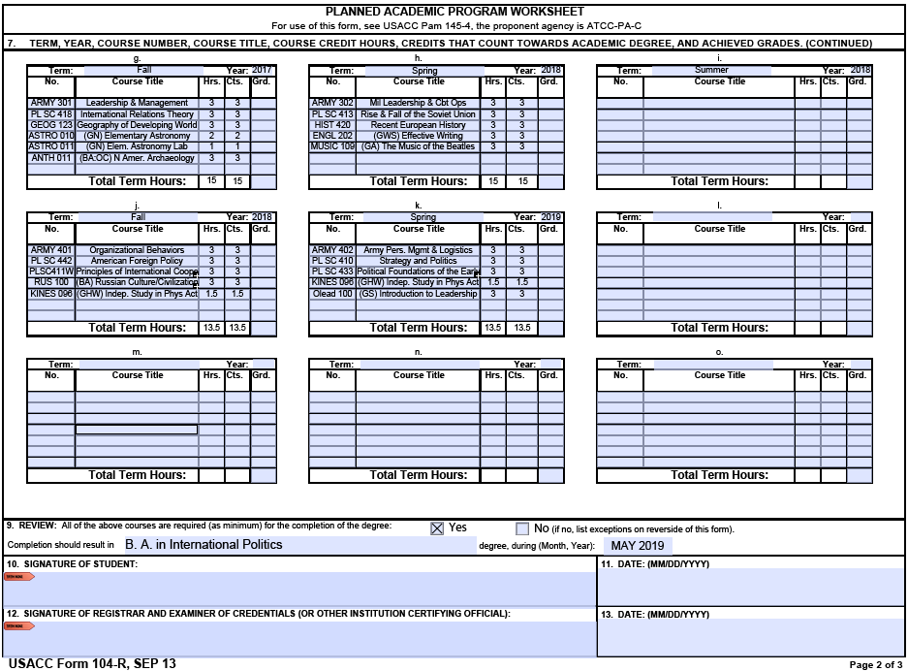
Notes:
Going back to our example, the classes for the last four semesters are entered on page 2 and block 9 is completed.

Slide 41
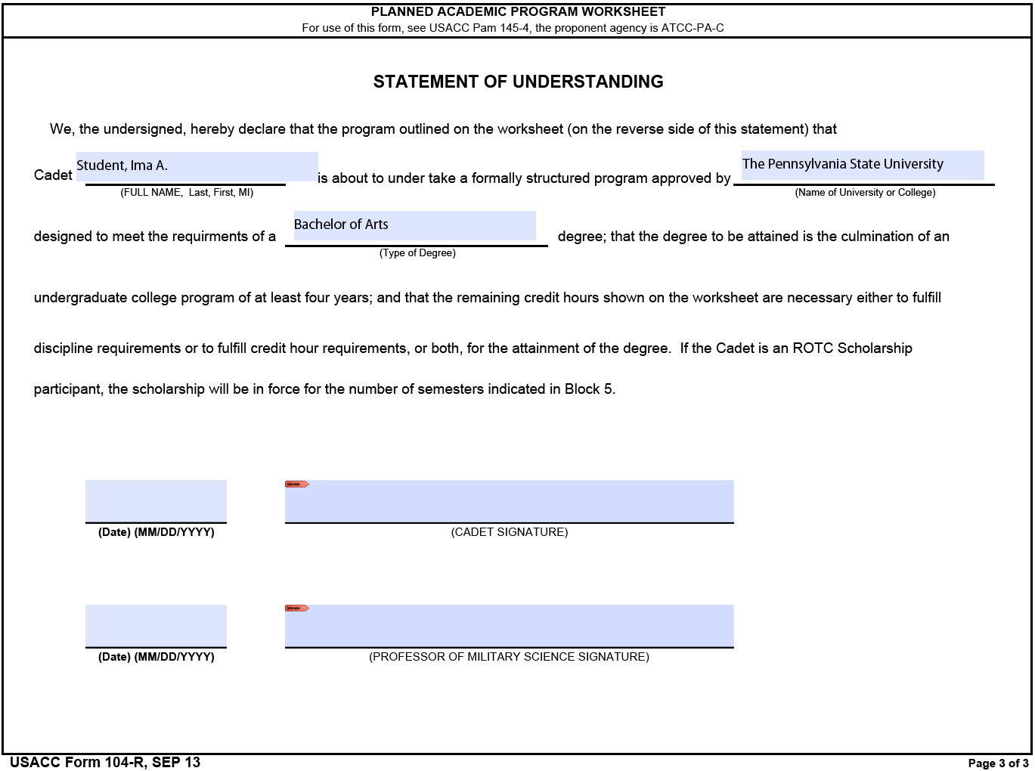
PAGE 3: Enter your name as Last, First Middle Initial. Name of University or College: The Pennsylvania State University. For “Type of Degree” enter “Bachelor of Arts” (or B.A.) or Bachelor of Science (or B.S.). Sign and date (Cadet Signature).
Notes:
Where prompted, enter your name as Last, First Middle Initial. For Name of University or College, enter the school that you are attending. For “Type of Degree” use the same information as you entered in block 9. Sign the form but do NOT date the Cadet signature block on page 3 until the Professor of Military Science has completed his block or unless instructed by the ROO or your Military Science instructor.

Slide 42
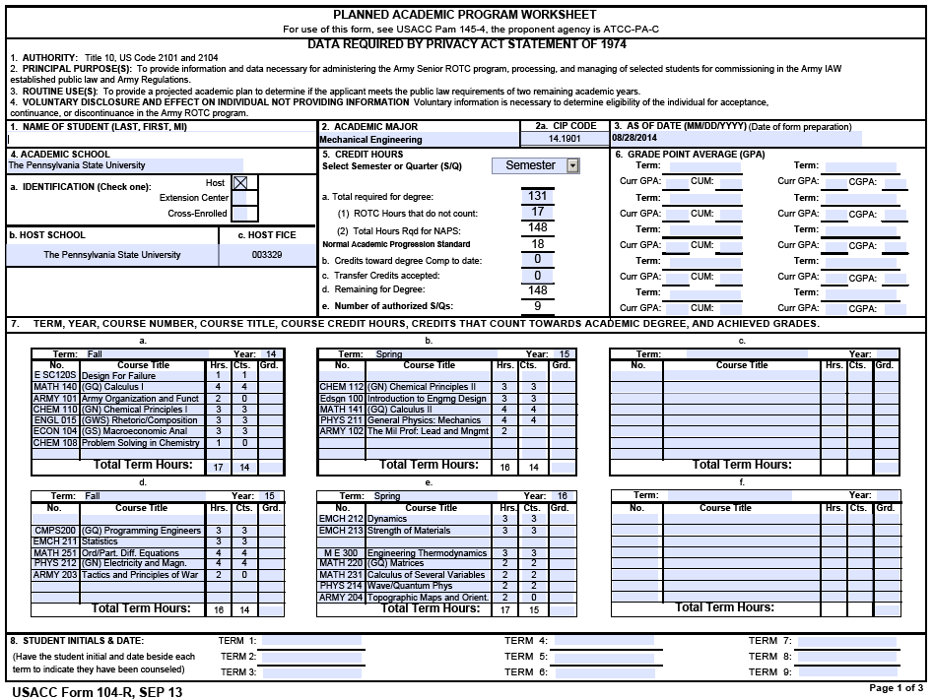
Example page 1 for an engineering major. Notice the numbers in block 5. Because of number of credits for the degree and that 17 ROTC credits do not count, the student is allowed 9 semesters.
Notes:
Here is an actual 104-R for a mechanical engineering Cadet. Notice the numbers in block 5. Because of number of credits for the degree and that 17 ROTC credits do not count, the student is allowed 9 semesters.

Slide 43
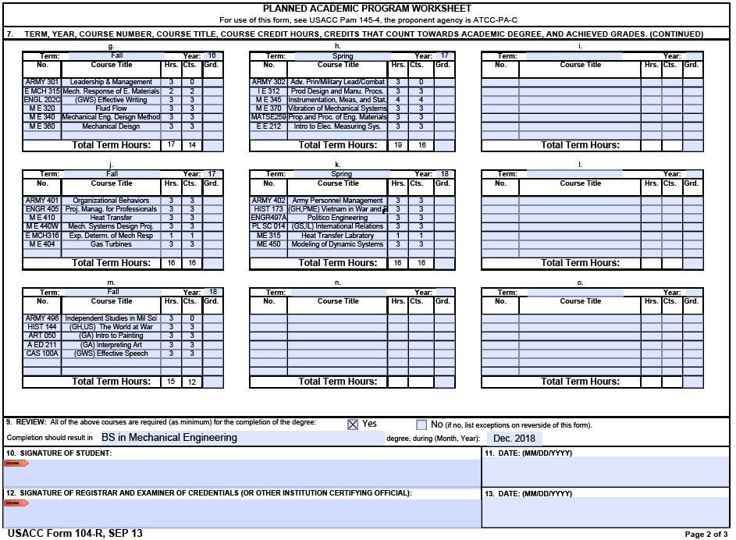
Example page 2 for an engineering major. Note that because block 5 authorized 9 semesters, this form covers 4-1/2 years. Move four Gen Eds to the 9th semester and add ARMY 496 (Independent Studies in Military Science). Note that only ARMY 401 and 402 count toward this degree.
Notes:
Because block 5 authorized 9 semesters, this form covers 4-1/2 years. Move four Gen Eds from the junior and senior years to the 9th semester and add ARMY 496 (Independent Studies in Military Science). Note that only ARMY 401 and 402 count toward this degree.
Each engineering department allows students who complete the ROTC program to count six credits of ROTC for the major. A few departments specify that you only need to complete the first two years to have six ROTC credit count. Each department specified what classes the ROTC credits substitute for. Most state that three ROTC credits can be used in lieu of three GHW (GHA) credits and three ROTC credits can be used in lieu of some type of technical elective or a specific class or classes. Most of the engineering recommended academic plans specify the allowed substitutions on the bottom or second page of the plan. You may need to look up this information on the department website. Look for a “handbook” for the major. The handbook typically includes this information.

Slide 44
USACC 104-R Checklist (1 of 2)
Sep 2013 version of 104R (or later) in Adobe pdf format only
All earlier versions need to be redone. Excel versions are not authorized.
Block 2 (Academic Major)
Just name of degree with option, if applicable, in parenthesis
Block 3 (As of Date) – needs to be current (Date of Form Completion/Update)
Block 4 – HOST School is “Pennsylvania State University” and HOST FICE is 003329
Block 5 – Credit Hours – the most important part of 104-R
5a – Minimum number of credits per the University Bulletin. The total number of credits under Counts (Cts.) in every semester in block 7 (plus transfer credits in block 5c) should equal 5a.
5a(2) - The total number of credit hours (Hrs.) in every semester in block 7 (plus transfer credits in block 5c) should be equal or up to two credits more than 5a(2). Three or more indicate unnecessary class(es).
5b – should equal the number of credit hours for classes with grades. Include all ARMY classes, but do not include other classes that do not count for your degree.
5c – Total number of transfer and AP credits that count toward degree requirements other than electives.
5d – should equal exactly the number of credit hours under Hrs. on remaining, uncompleted semester blocks.
5e – should equal the number of remaining, uncompleted semesters.
Notes:
You should take a screen shot of this slide and the next slide.

Slide 45
USACC 104-R Checklist (2 of 2)
Block 7 – Should be in the format - Fall, Spring, Summer
Each row (across) list one school year in Fall, Spring, Summer format
Only completed classes and future REQUIRED internships can be listed in Summer
Course Number Block (example: Cmpsc101) totally visible / legible
Courses selected to meet Gen Ed, BA, and PME requirements marked in course title
A number must be entered in BOTH the Hrs. and Cts. Column (zeros may not appear)
All completed semesters should have GPAs received (box 6) and letter grades (box 7)
Verify one History Course from Professional Military Education Course List is planned
Ensure all ARMY classes are listed.
Block 8 – Leave blank if first 104-R. When the Cadet reviews their 104-R with their ARMY instructor, they initial and date when counseled in the previous semesters plus current semester. As 104-R is reviewed each semesters, then initial and date for that term. Do NOT duplicate dates.
Block 9 – Review
“Yes” checked and Type of Degree listed (type of degree and major is acceptable).
Grad Date in (Month, Year) format (example May, 2022; 05/22 or 0522).
Verify that Grad Date matches the last semester listed (i.e. Grad Date 0522 = Spring 2022)
Block 10/Page 3 – Cadets need to sign both pages
Block 12 – Final 104R requires Academic Advisor’s signature
Page 3 – Name, Academic School (Penn State), and Type of Degree (BA/BS) filled-in

Slide 46
OTHER NOTES (1 of 2)
Write the 104-R for only one major and no minors (the Military Studies minor can be obtained by selecting Gen Ed classes that can also count for the minor). Cadet Command will not pay for a dual major nor allow you to delay your graduation for a second major. If you double major, you must write the 104-R for the one major that you want the most. You cannot miss required summer training to take classes for the double major.
No semester should have more than 18 credits. In rare cases, one semester may have 19, but never more than 19. Even out the credit load to avoid overloading any semester.
Before seeing your advisor to have them review and sign the form, have your Military Science Instructor review your 104-R to ensure all administrative data is correct.
Print the USACC form 104-R on three separate pages. That way minor corrections to page one will not require your advisor to sign the updated form.
Update your 104-R after every semester by entering your semester GPA and cumulative GPA in block 6 and the letter grade for each course completed in section 7. Then meet with your Military Science Instructor review your 104-R. Initial and date block 8 at the end of that meeting. Keep track of your 104-R review dates.
Notes:
Finally, a few additional notes. You should take a screen shot of this and the following slide as well.
<Read slide>

Slide 47
OTHER NOTES (2 of 2)
You can change your selection of courses as long as you continue to make satisfactory academic progress. That means that you are taking classes that count for your degree and you will graduate by the date specified in your ROTC contract.
If you change a class, the new class must meet the requirement that the original one satisfied or meets a requirement that you planned to satisfy in a future semester. For example you had planned to take INART 205 to meet one of your GA required classes, but it is full. You can either swap it for a different GA class or switch it for another class that you planned to take later, preferably a different Gen Ed or BA class. WARNING: DO NOT TO MISS ANY PRE-REQUISITE CLASS(ES) IF YOU MOVE CLASSES.
Some classes, typically upper-level (300- and 400-level) are only offered once a year. A few are only offered once every two years.
Page 1 will round up courses with half credits and leave the cell blank if you enter “0” under “Hrs.” (credit hours) or “Cts.” (number that counts toward degree)
If you change your plan, you need to update your 104-R and have your advisor check and sign the revised form.
Notes:
<Read slide>
I know that is a lot of information in one briefing. Review the video as you work through the different tasks to prepare the form. You are planning your undergraduate years. An hour or two of quality planning now will prevent problems in the future.
Thank you for listening and good luck on your college and ROTC careers.

Slide 48
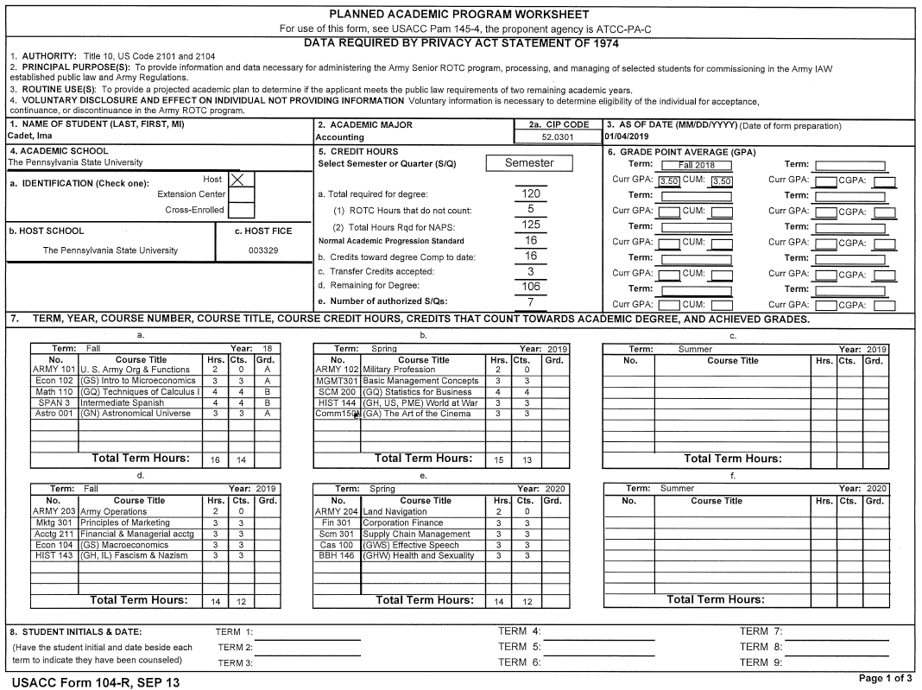
SEMESTER UPDATES TO A 104-R
Block 5b. Total number of credits toward degree completed to date at Penn State (add in ROTC credits that do not count toward your degree and any summer credits taken at any Penn State campus). Do NOT include transfer or AP credits.
Block 3, As of Date: should be after end of last semester
Block 6: Add most current completed semester, term GPA and CGPA
Block 7. Enter the letter grade for all classes of completed semesters. Include late dropped classes using “LD” as the grade.
Block 5c. Total number of transfer and AP credits that COUNT toward your degree ONLY.
IAC
15SEP18
IAC
20JAN19
Block 8. Initial current semester. Do NOT initial for future semesters.

Slide 49
How to instantly tell if the 104-R form is valid
(or the form was completed on an Apple/MAC)

Slide 50
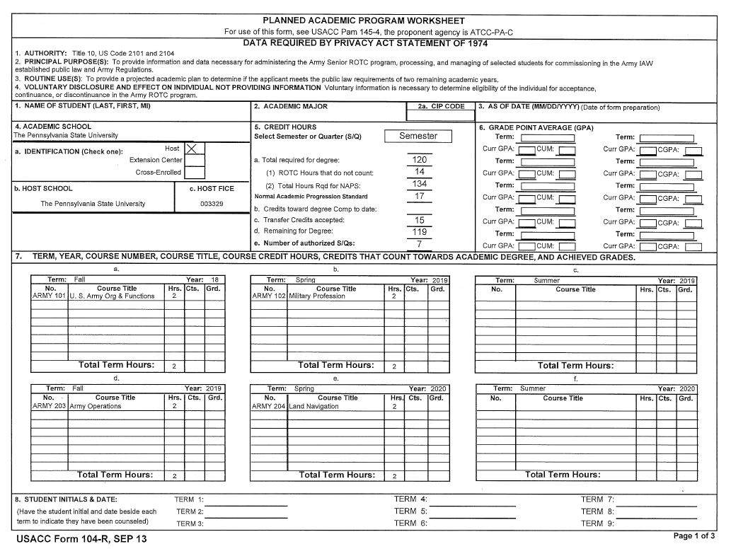
VALID FORM
No decimal point in Normal Academic Progression Standard
The word “Semester” is spelled out.
5a + 5a(1) = 5a(2)
A semester’s worth of completed and/or transfer credits reduces both 5d. the number of credits remaining and 5e the number of auth. Semesters.
Form version is SEP 13. The computer file type MUST be .pdf and the form MUST be completed on a PC.

Slide 51
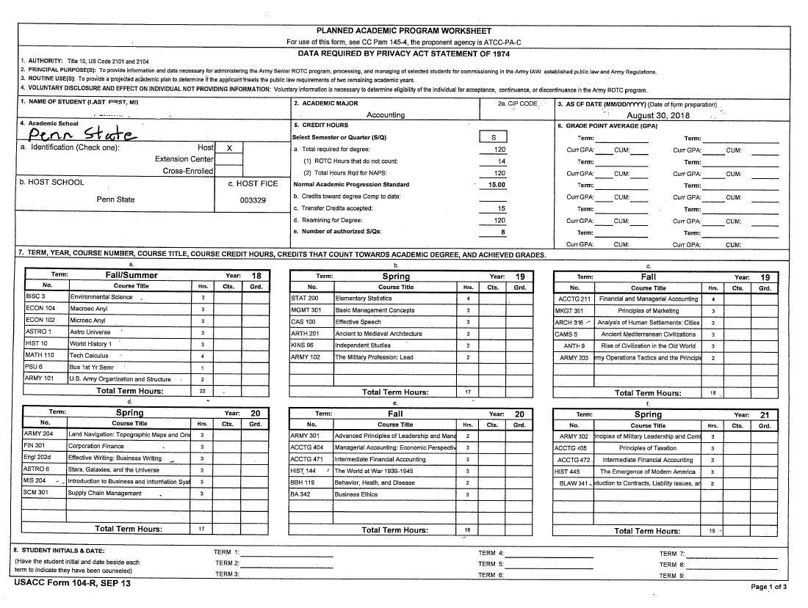
INVALID FORM
Has decimal point out to two places in Normal Academic Progression Standard
5a + 5a(1) does not equal 5a(2)
The word “Semester” is not spelled out.
A semester’s worth of transfer credits does not reduce neither 5d. the number of credits remaining nor 5e the number of auth. Semesters.
Form looks more like an Excel spreadsheet.

Slide 52
Click on the link at the bottom to access 104-Rs that have been partially-completed for select majors.
In the partially-completed 104-Rs, you will need to: - Enter the appropriate year for each semester in section 7
- Replace XXX ### with the course number for that class. If the course title for one of these entries says “(GA) Gen Ed in Arts”, enter (GA) then the name of the course. For example, replace: XXX ### | (GA) Gen Ed in Arts
with: THEA 100 | (GA) Art of the Theatre
- Where you must select one choice from a list of options, pick one of the options and fill in the course number under No. and course name under Course Title. For example, replace: HIST 130 | (GH) pick 130,143,144 or 173
with: HIST 144 | (GH,US.PME) World War II
Remember: Each requirement must have the name and number of an actual course that fulfills that requirement. Do NOT leave the placeholder (like “Gen Ed in Humanities” or “Two-piece Sequence” – replace the placeholder with a course name and number.

